Slide 1



Tight Pickle Productions

Slide 2
Trailer

Slide 3
Poster/ Case Design

Slide 4
The game itself

Slide 5
Play test results
Feedback
Negative / positive
Improvements

Slide 6
Cost Calculations

Slide 7
Trello

Slide 8
Glynn Leine (engineer)
Everything that has to do with coding
Arduino Leanardo

Slide 9
Dominique de Graaff (designer)
PowerPoint presentations
Website
Game and trailer synopsis
Create the design for the speaker and light output
Laser cut the board
Playtest

Slide 10
Rick Oosthof
Create the controller
Level Design

Slide 11
Rob O’Connor
Art stuff
Filming and editing the trailer
Scrum Master
Animation

Slide 12
Georgi Statev
Art stuff
Tiles
animation

Slide 13
Teamwork
Reflection
Communication could be better
Be at school on time
Peer assessment
Roles (examples)

Slide 14
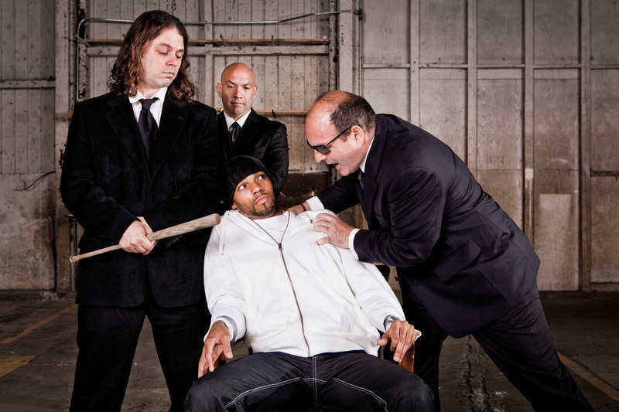
Questions?

